Slide 1

Kubernetes

Slide 2
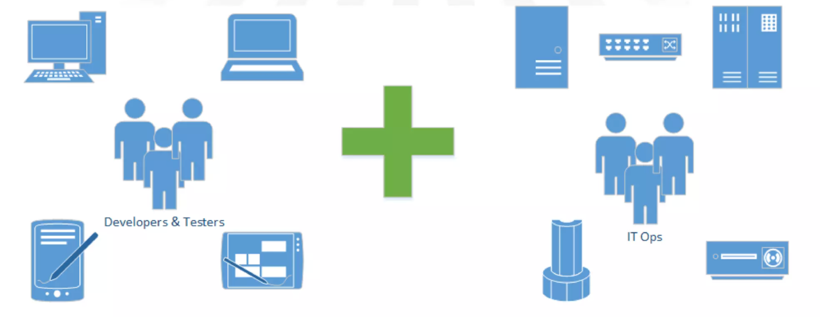
Before DevOps

Slide 3
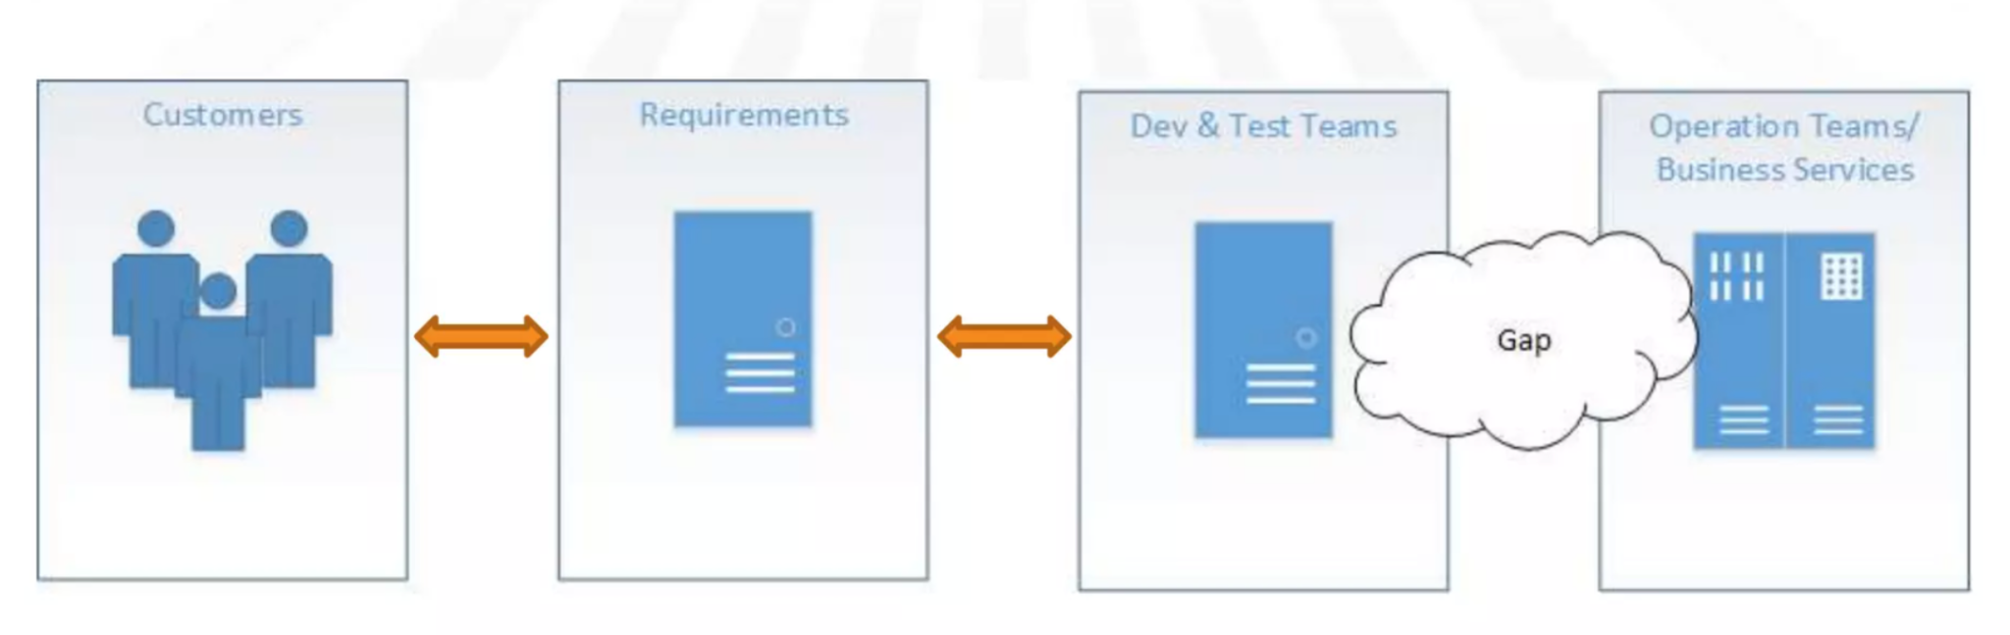
Why DevOps?

Slide 4
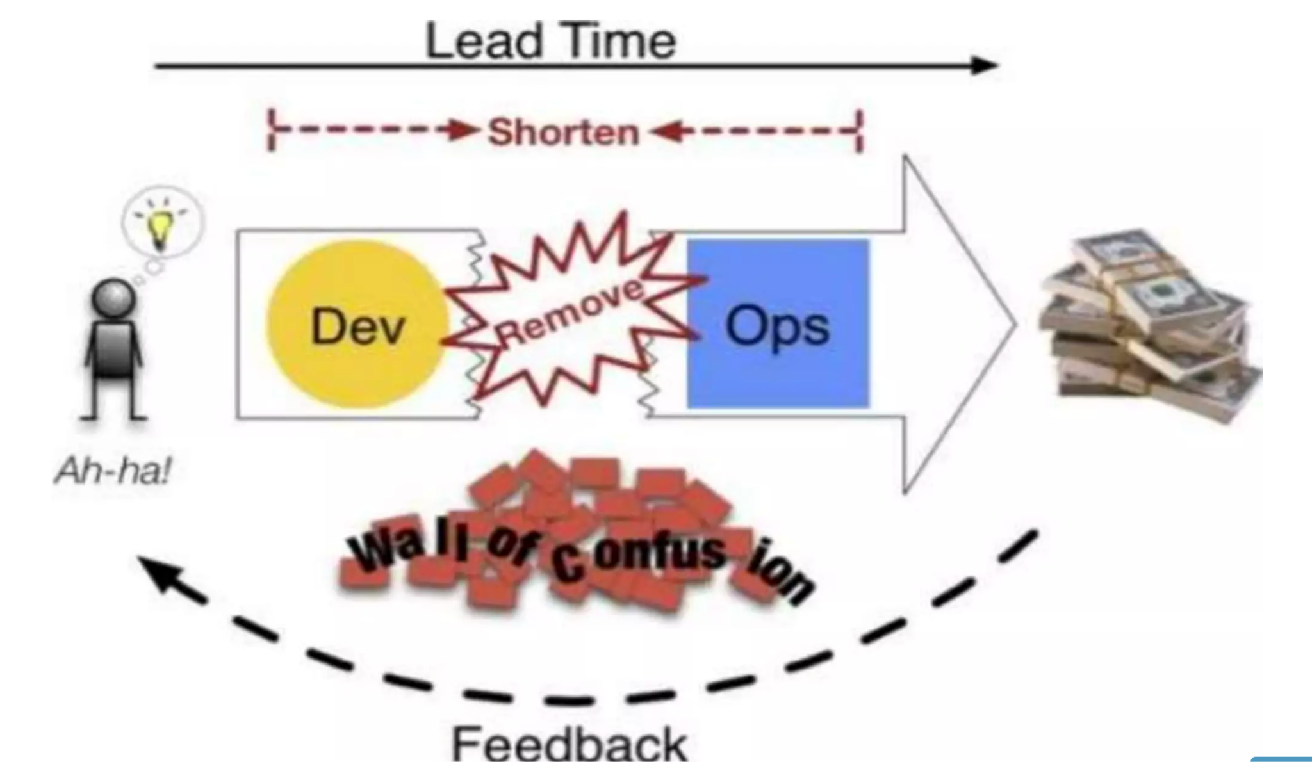
Why DevOps?

Slide 5
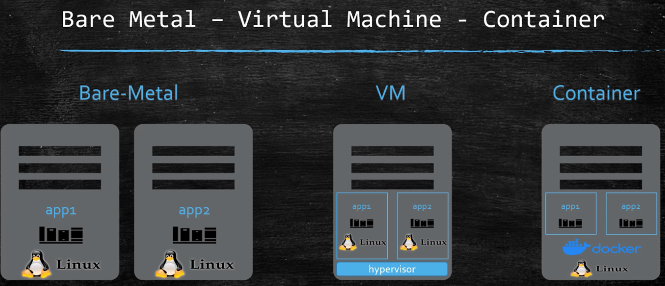
Containerization

Slide 6
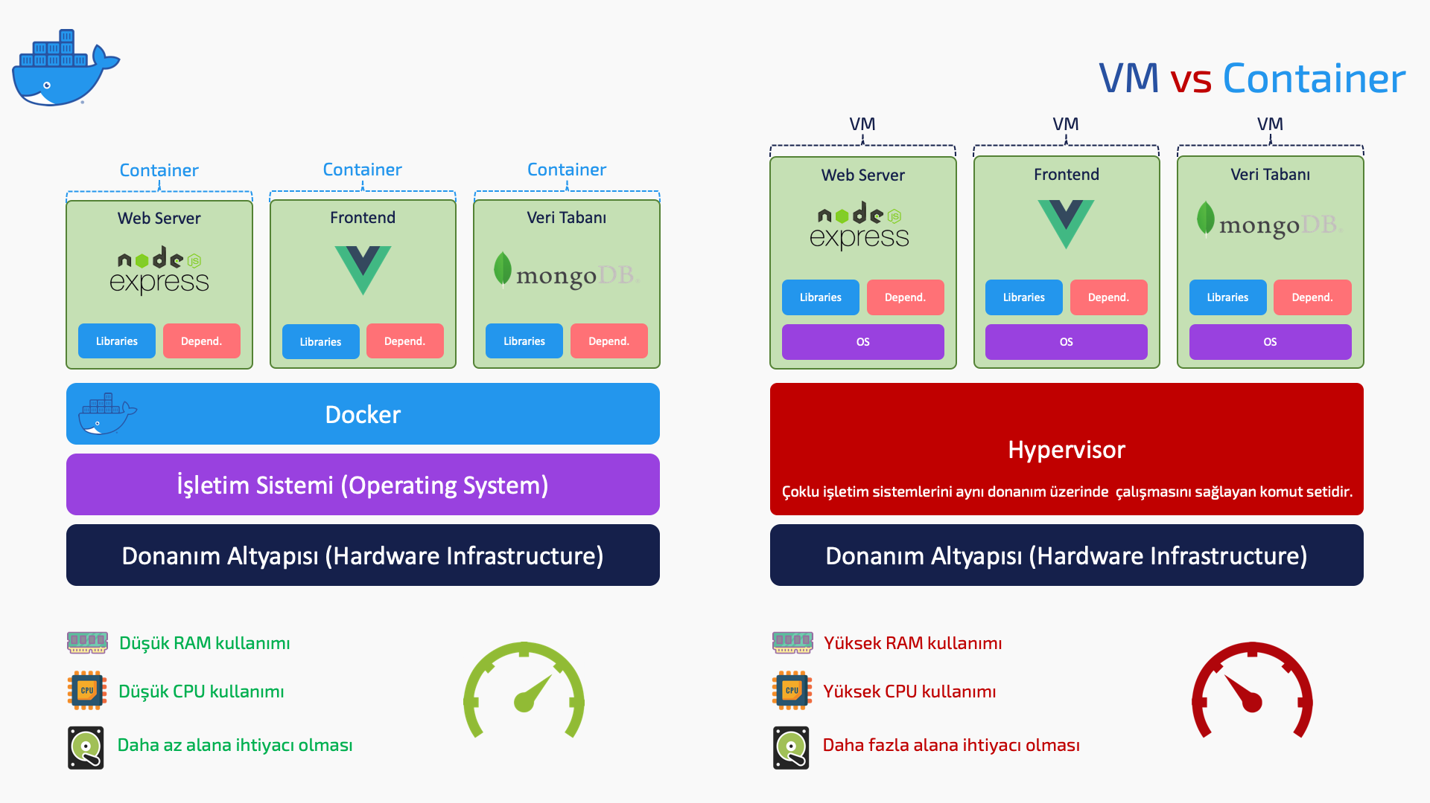
Containerization

Slide 7

Containerization
Application Isolation
Rapid Deployment and Scalability
Portability
Lightweight and Speed
Continuous Integration and Delivery (CI/CD)
Orchestration (Kubernetes)

Slide 8

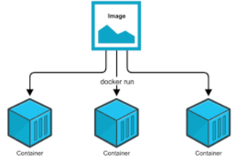
Containerization

Slide 9
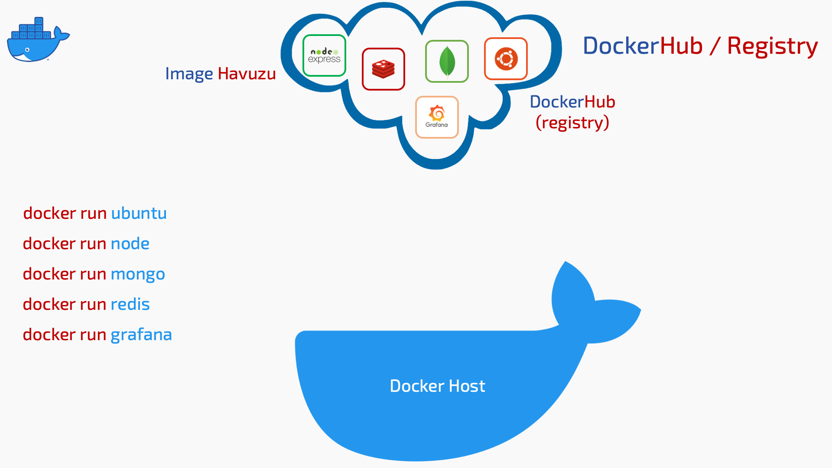
Containerization

Slide 10

Containerization

Slide 11
KUBERNETES

Slide 12
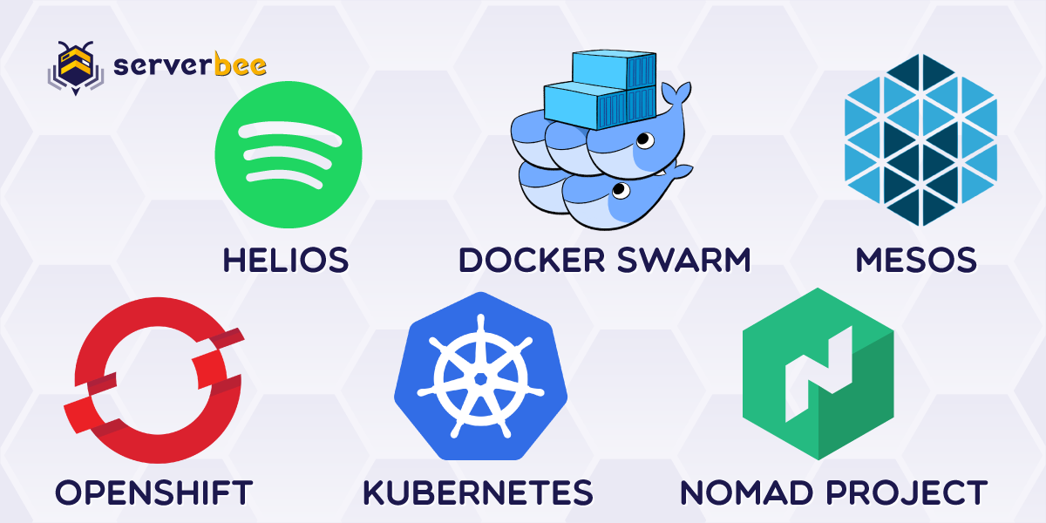
Kubernetes
Orchestration
Orchestration
Containers are great, but when you get lots of them running, at some point, you need them all working together in harmony to solve business problems.
Tools to manage, scale, and maintain containerized applications are called orchestrators, and the most common example of this is Kubernetes.

Slide 13
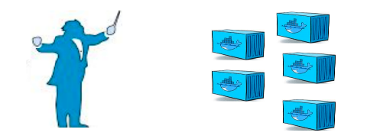
Kubernetes
Orchestration
Container orchestration is used to automate the following tasks at scale:
Provisioning and deployments of containers
Availability of containers
Load balancing, traffic routing and service discovery of containers
Health monitoring of containers
Securing the interactions between containers.
Configuring and scheduling of containers
Allocation of resources between containers

Slide 14
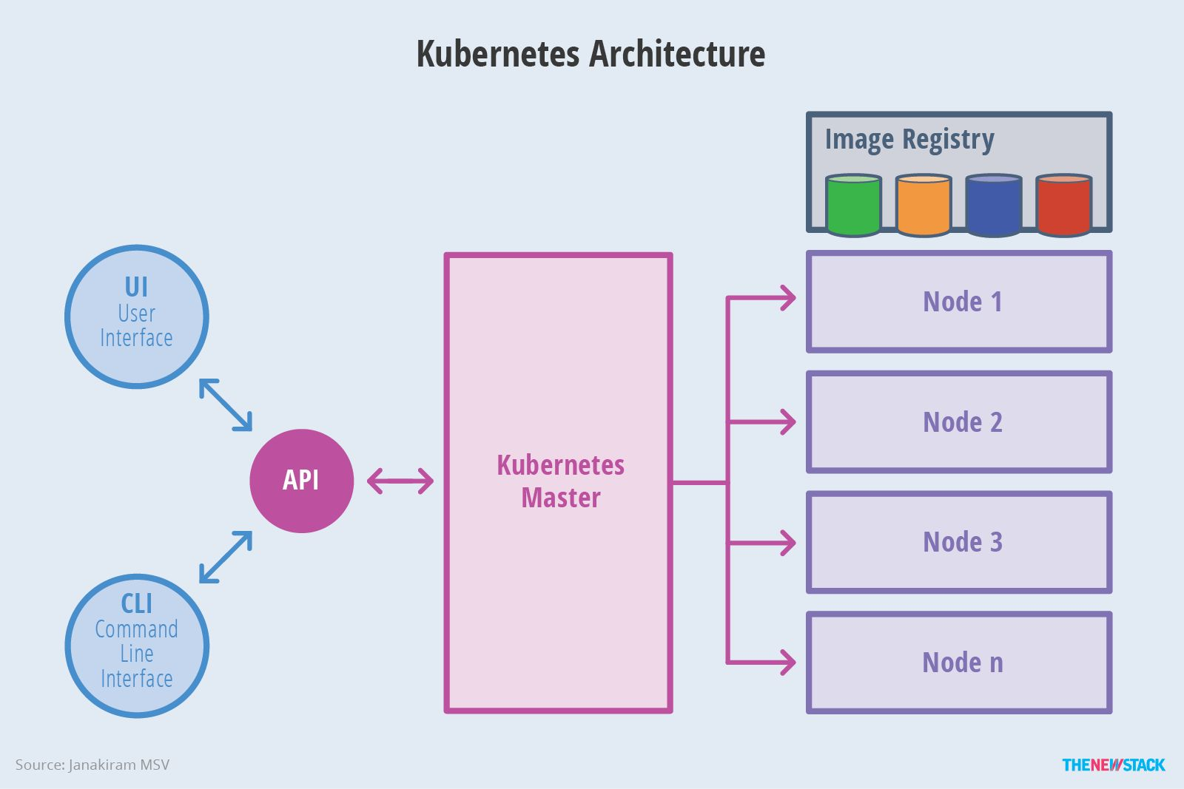
Kubernetes
Kubernetes Components
Kubernetes has the following main components:
• One or more master nodes
• One or more worker nodes.

Slide 15
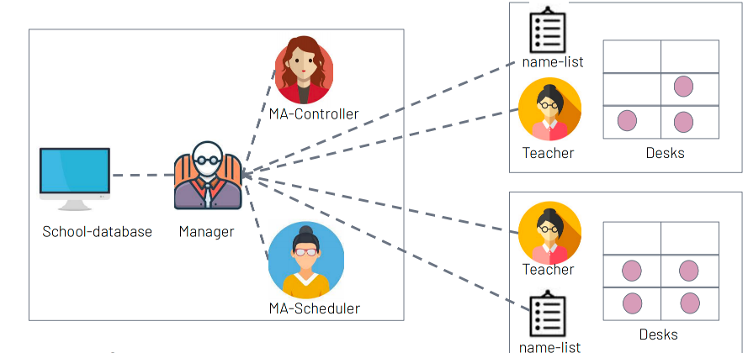
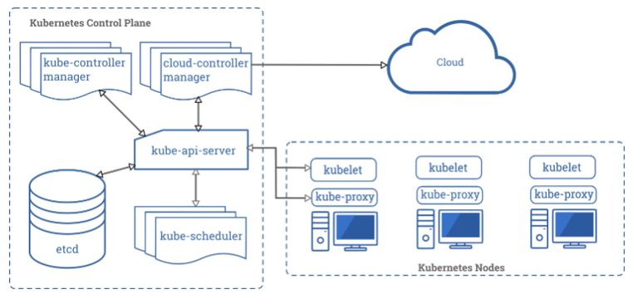
Kubernetes
Kubernetes Components

Slide 16
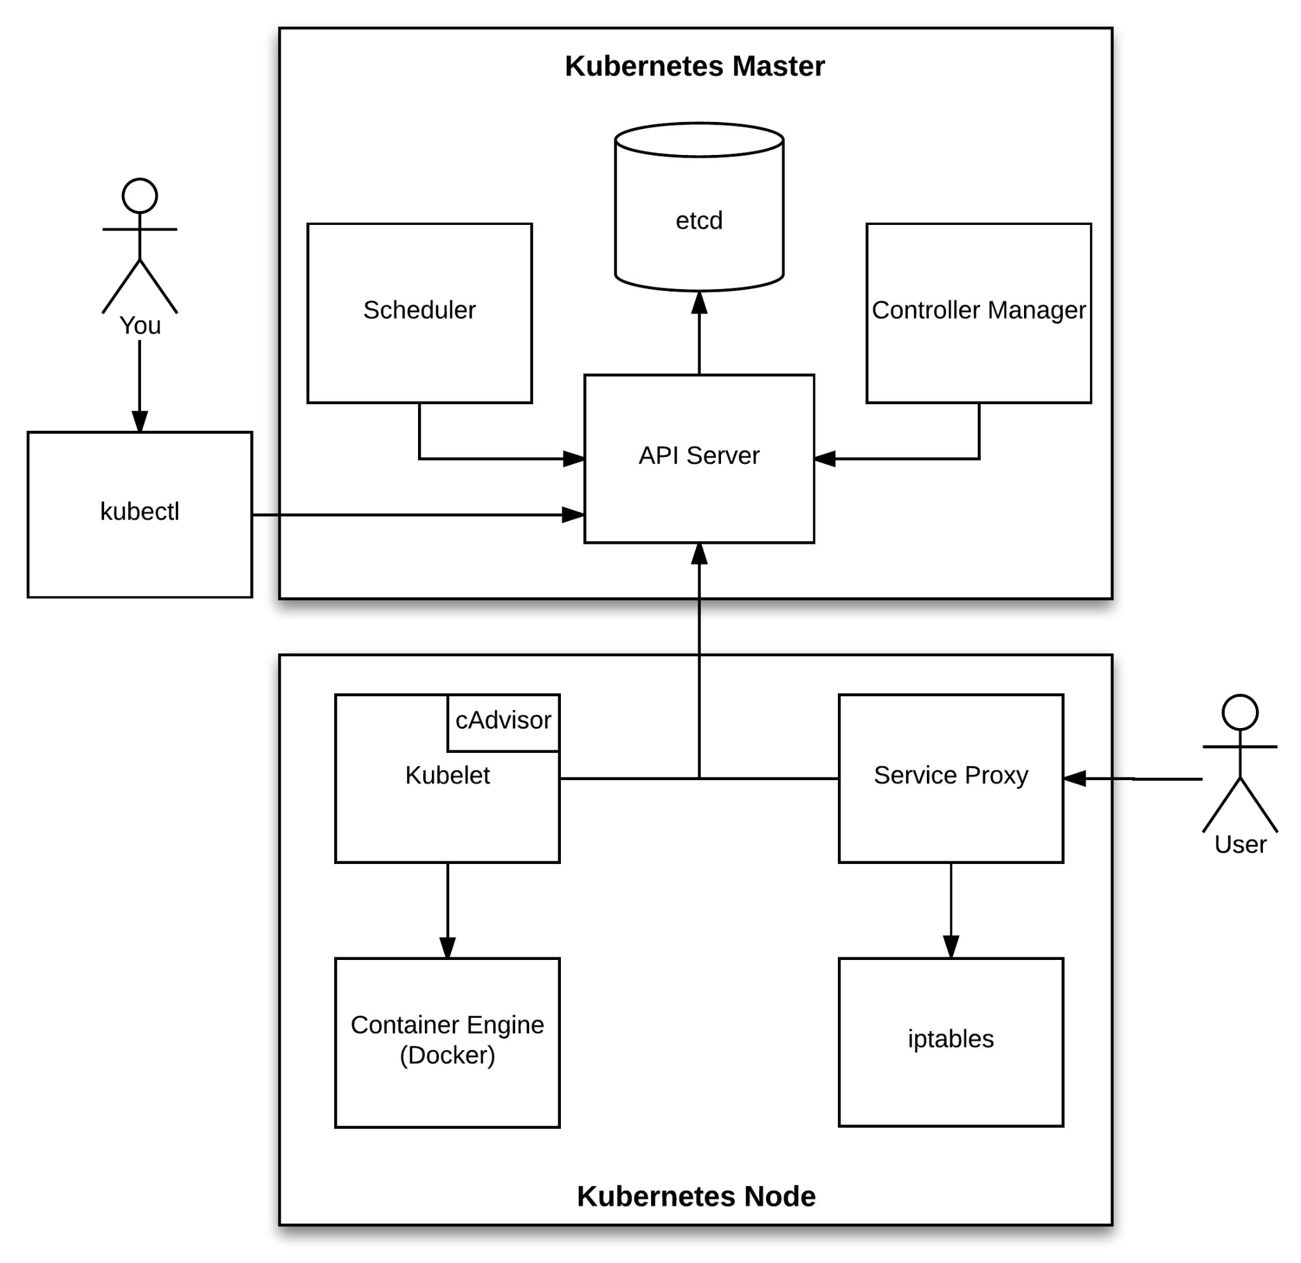
Kubernetes
Kubernetes Components
kube-apiserver:
● Provides a forward facing REST interface into the kubernetes control plane and datastore.
● All clients and other applications interact with kubernetes strictly through the API Server.
● Acts as the gatekeeper to the cluster by handling authentication and authorization, request validation, mutation, and admission control in addition to being the front-end to the backing datastore.
etcd:
● etcd acts as the cluster datastore.
● Purpose in relation to Kubernetes is to provide a strong, consistent and highly available key-value store for persisting cluster state.
● Stores objects and config information.

Slide 17
Kubernetes
Kubernetes Components
kube-controller-manager:
● Serves as the primary daemon that manages all core component control loops.
● Monitors the cluster state via the apiserver and steers the cluster
towards the desired state
kube-scheduler:
● Verbose policy-rich engine that evaluates workload requirements and attempts to place it on a matching resource.
●Workload Requirements can include: general hardware requirements, affinity/anti-affinity, labels, and other various custom resource requirements.

Slide 18
Kubernetes
Kubernetes Components
kubelet:
● Acts as the node agent responsible for managing the lifecycle of every pod on its host.
● Kubelet understands YAML container manifests that it can read from several sources.
kube-proxy:
● Manages the network rules on each node.
● Performs connection forwarding or load balancing for Kubernetes cluster services.

Slide 19
KUBERNETES Objects
▶ PODs
▶ ReplicaSets
▶ Deployment
▶ Namespaces
▶ Object Model

Slide 20
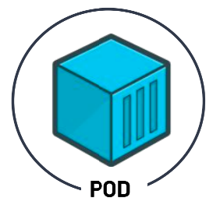
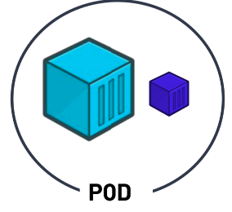
Kubernetes Objects
Pods
Kubernetes doesn't deal with containers directly.
PODs are Kubernetes objects that encapsulate the containers.
Pods are the smallest deployable units of computing that you can create and manage in Kubernetes.
A POD can have multiple containers.
Sometimes an application need a helper container, such as logging, monitoring, etc.
These helper containers should coexist with your application container.

Slide 21
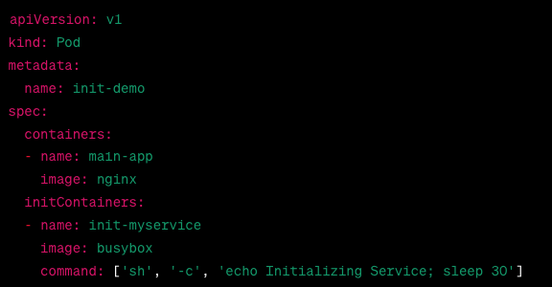
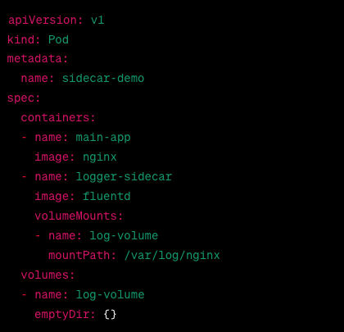
Kubernetes Objects
Pods

Slide 22
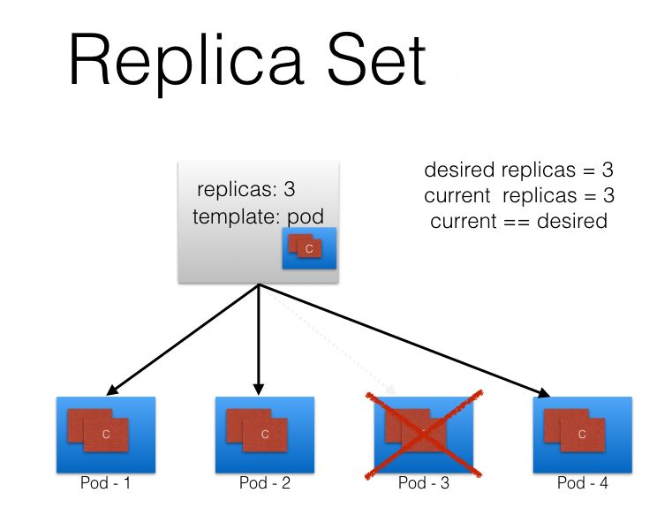
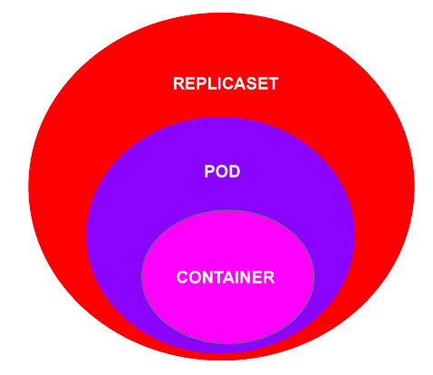
Kubernetes Objects
ReplicaSets
A ReplicaSet's purpose is to maintain a stable set of replica Pods running at any given time.
Even if you have a single POD, the ReplicaSet will bring up a new POD when the existing one fails.

Slide 23
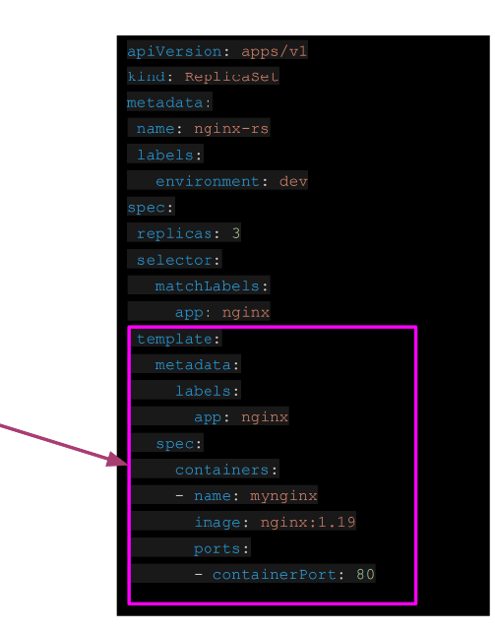
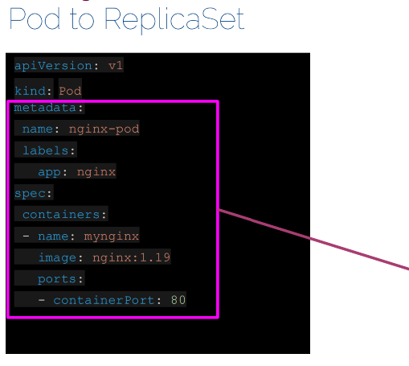
Kubernetes Objects
ReplicaSets

Slide 24
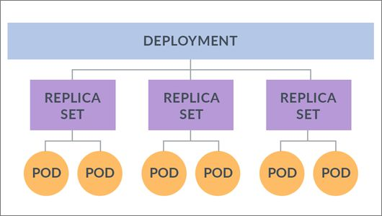
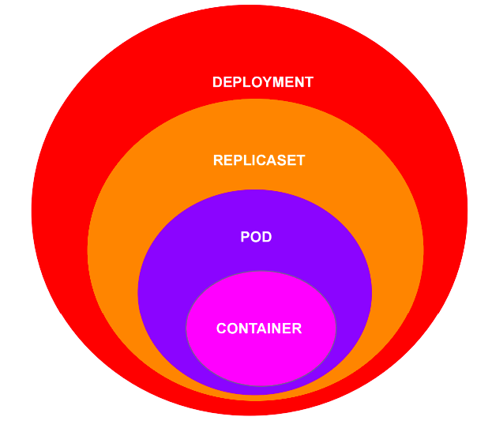
Kubernetes Objects
Deployment
One step higher in the hierarchy, deployments provides declarative updates for Pods and ReplicaSets.

Slide 25
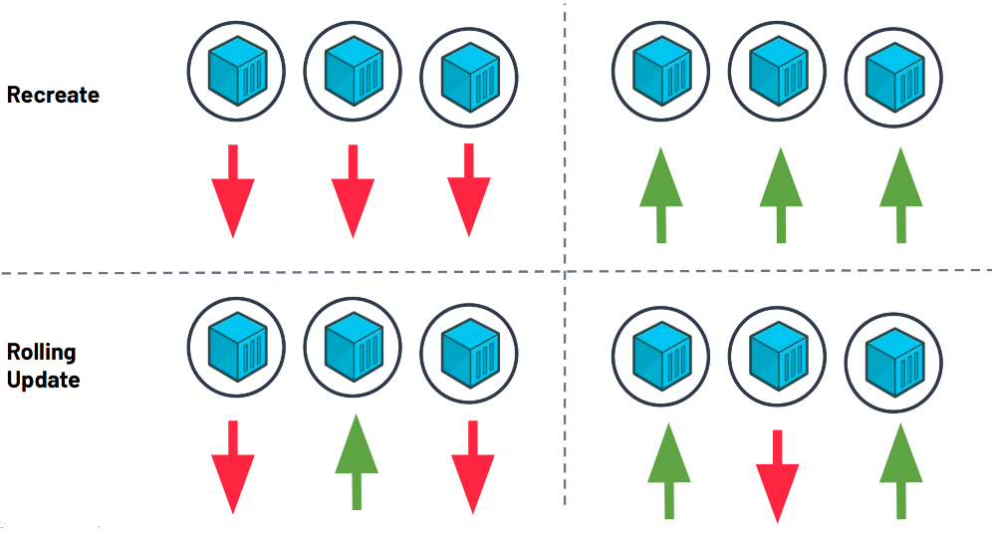
Kubernetes Objects
Deployment Strategy

Slide 26
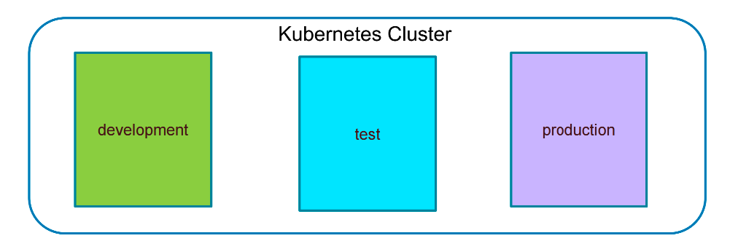
Kubernetes Objects
Namespaces
Kubernetes supports multiple virtual clusters backed by the same physical cluster. These virtual clusters are called namespaces.
Namespaces are intended for use in environments with many users spread across multiple teams, or projects.

Slide 27
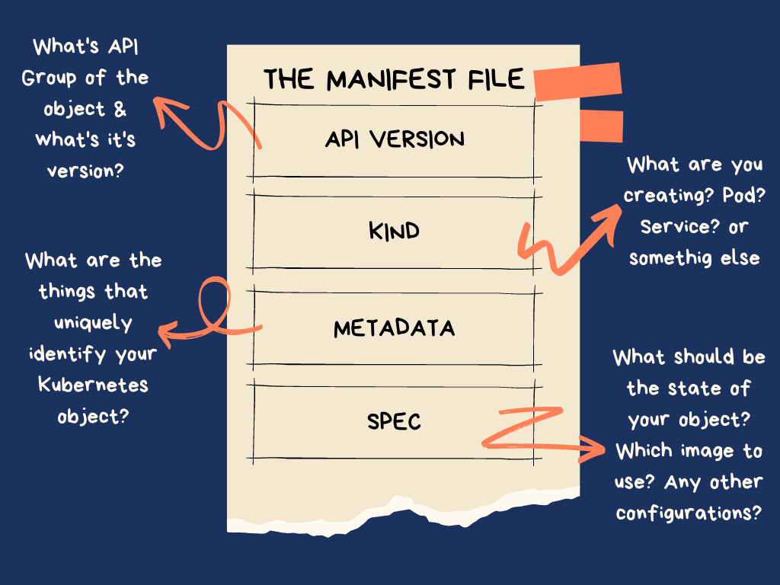
Kubernetes Objects
Object Model

Slide 28
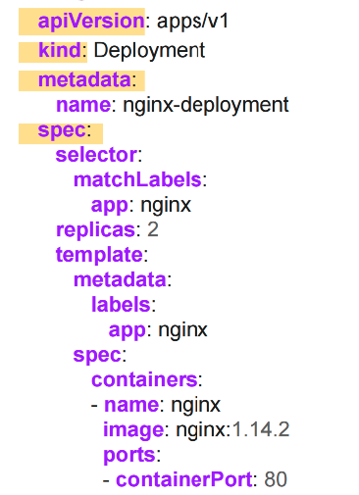
Kubernetes Objects
Object Model
All objects must have apiVersion, kind, metadata and spec fields.
apiVersion: Which version of the Kubernetes API you're using to create this object
kind: What kind of object you want to create
metadata: Data that helps uniquely identify the object, including a name string, labels, and optional namespace
spec: What state you desire for the object

Slide 29
KUBERNETES Networking
▶ Cluster Networking
▶ Services
▶ Service Types
▶ Ingress

Slide 30
Kubernetes Networking
Cluster Networking
There are 4 distinct networking problems to address:
1. container-to-container communications:
2. Pod-to-Pod communications:
3. Pod-to-Service communications: this is covered by services.
4. External-to-Service communications: this is covered by services.

Slide 31
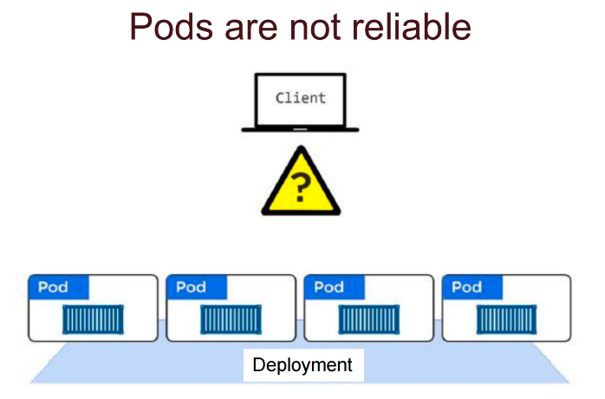
Kubernetes Networking
Services

Slide 32
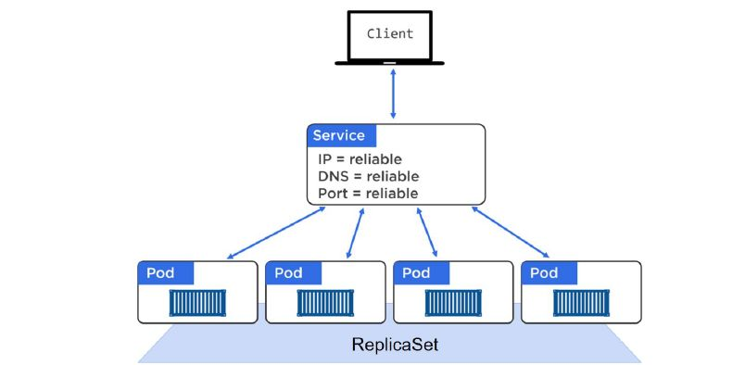
Kubernetes Networking
Services
A Service offers a single DNS entry for a containerized application managed by the Kubernetes cluster
The Service is associated with the Pods, and provides them with a stable IP, DNS and port. It also loadbalances requests across the Pods.

Slide 33
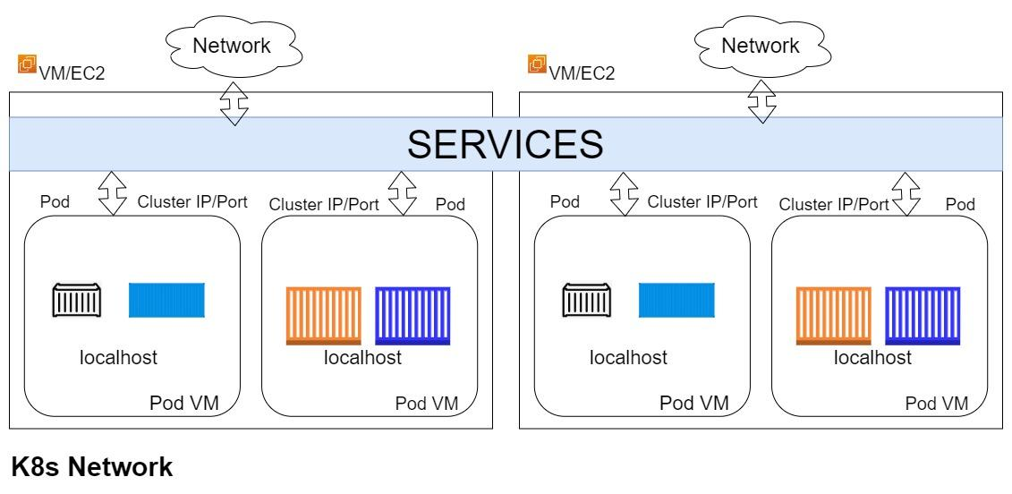
Kubernetes Networking
Services

Slide 34
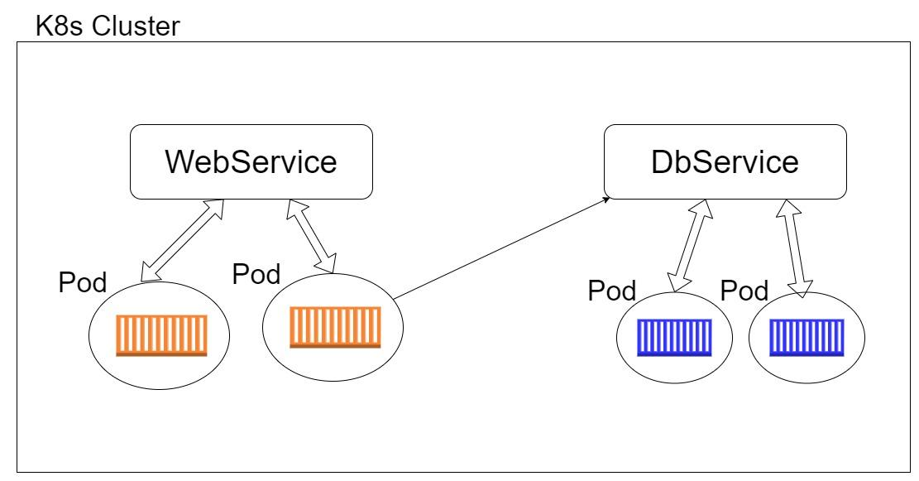
Kubernetes Networking
Services

Slide 35
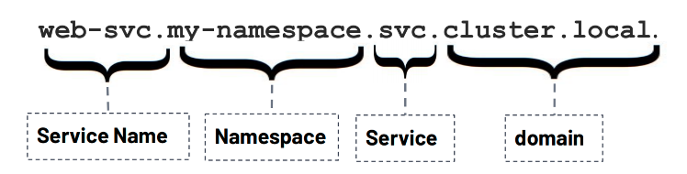
Kubernetes Networking
Services Discovery
Kubernetes has an add-on for DNS, which creates a DNS record for each Service and its format is

Slide 36
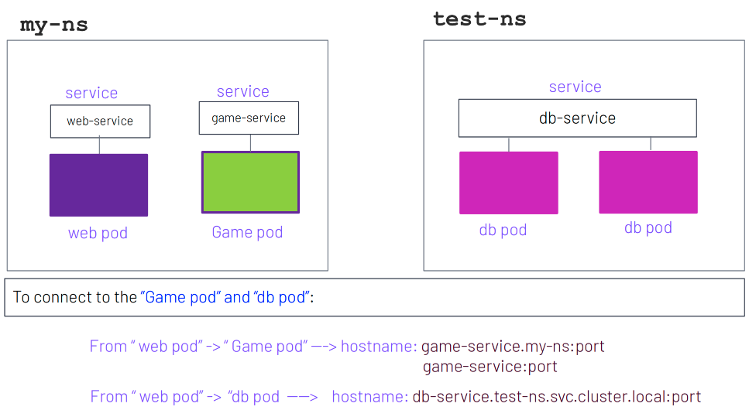
Kubernetes Networking
Services Discovery

Slide 37
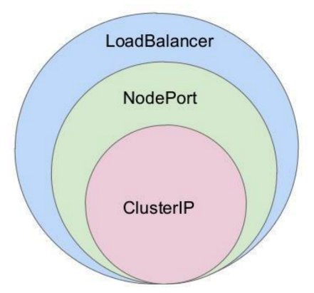
Kubernetes Networking
Services Types
There are 3 major service types:
• ClusterIP (default)
• NodePort
• LoadBalancer

Slide 38
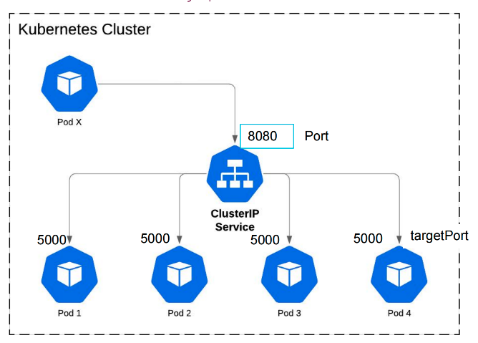
Kubernetes Networking
ClusterIP
Expose traffic internally
Example Usecase:
Good for service of frontend & back-end apps.

Slide 39
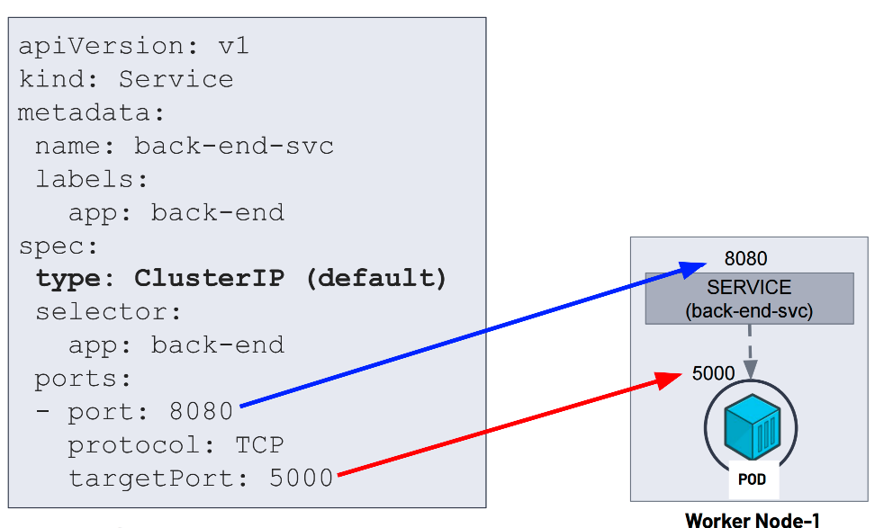
Kubernetes Networking
ClusterIP

Slide 40
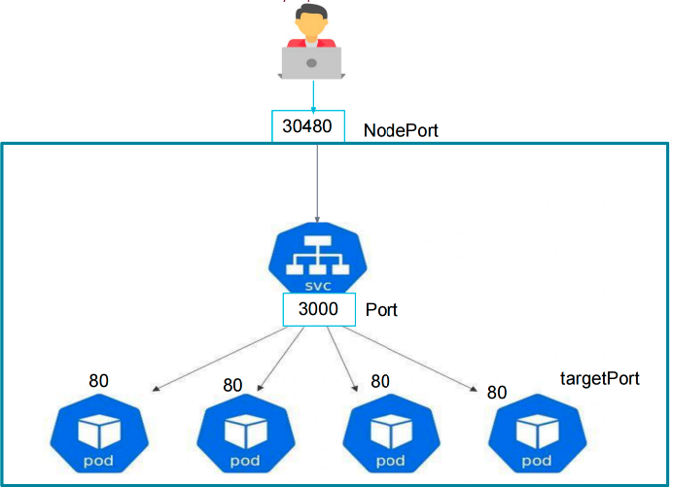
Kubernetes Networking
NodePort
Exposes traffic to the outside.
Example Use Case:
when we want to make our Services which has our app or website accessible from the
external world.

Slide 41
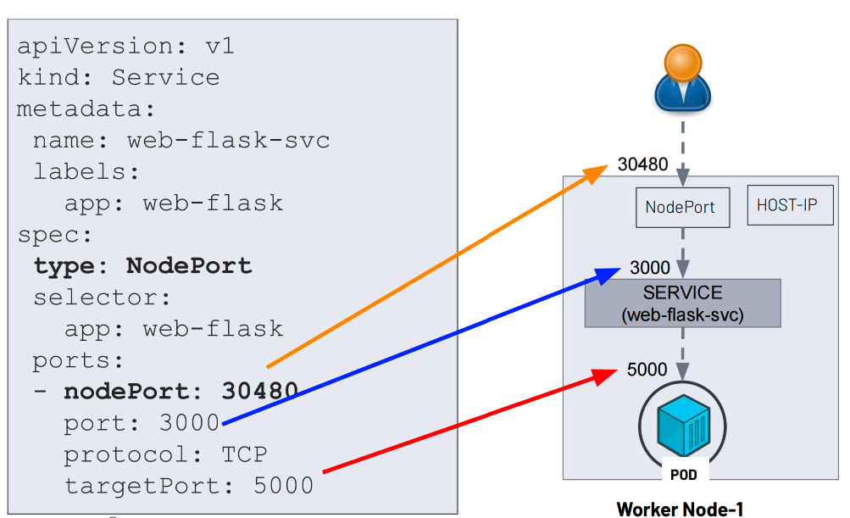
Kubernetes Networking
NodePort

Slide 42
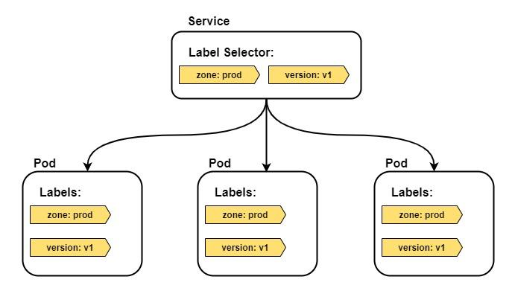
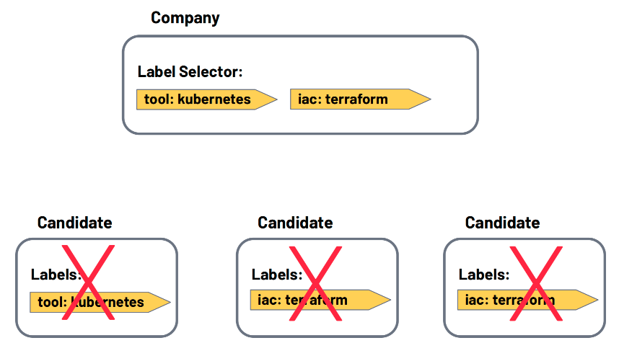
Kubernetes Networking
Labels and loose coupling

Slide 43
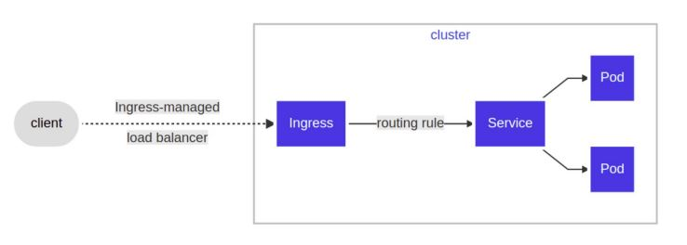
Kubernetes Networking
Ingress:With Ingress, users do not connect directly to a Service. Users reach the Ingress endpoint, and, from there, the request is forwarded to the desired Service.

Slide 44
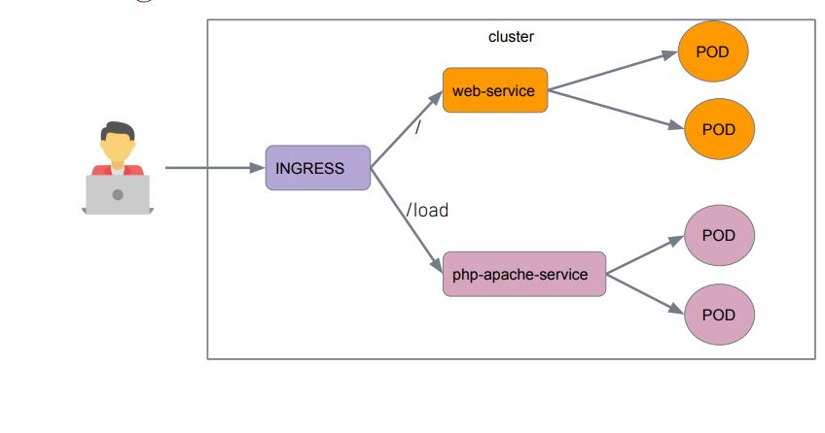
Kubernetes Networking
Ingress

Slide 45
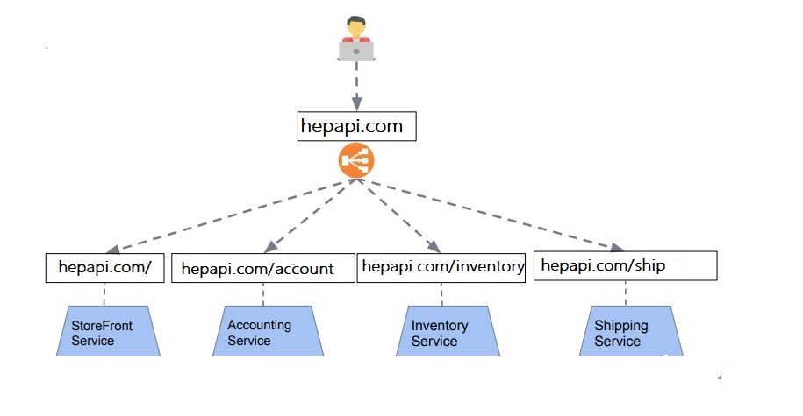
Kubernetes Networking
Ingress:exposes HTTP and HTTPS routes from outside the cluster to services within the cluster.

Slide 46
Secrets and Configmaps

Slide 47
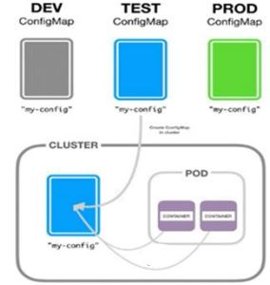
ConfigMap
ConfigMap is an API object used to store non-confidential data in key-value pairs. Pods can consume ConfigMaps as environment variables, command-line arguments, or as configuration files in a volume.

Slide 48
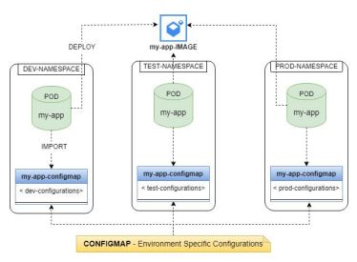
ConfigMap
A ConfigMap allows you to decouple environment-specific configuration from your container images, so that your applications are easily portable.

Slide 49
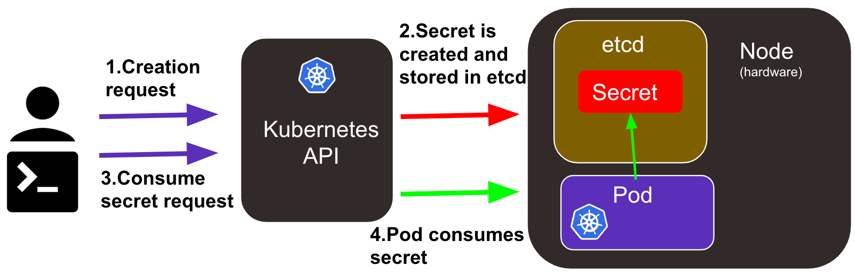
Secrets
A Secret is an object that contains a small amount of sensitive data such as a password, a token, or a key. Such information might otherwise be put in a Pod specification or in an image.

Slide 50
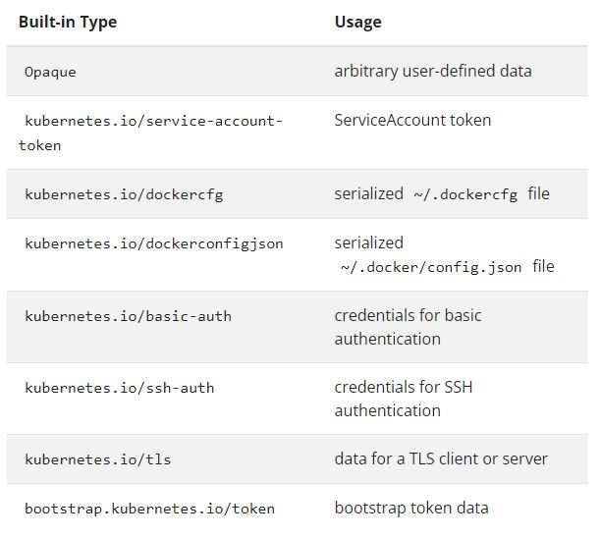
Secrets
Opaque is the default Secret type if omitted from a Secret configuration file. When you create a Secret using kubectl, you will use the generic subcommand to indicate an Opaque Secret type.

Slide 51
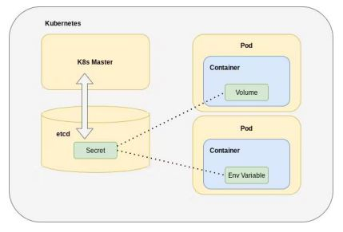
Secrets
Secrets can be mounted as data volumes or exposed as environment variables to be used by a container in a Pod.

Slide 52
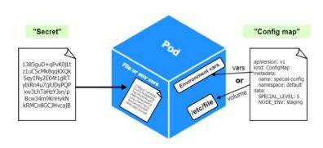
ConfigMap and Secret

Slide 53
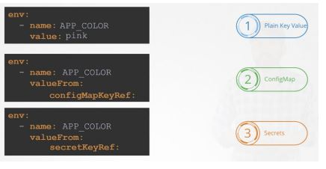
ConfigMap and Secret

Slide 54
KUBERNETES Storage
▶ Volumes
▶ Volume Types
▶ PersistentVolume & PersistentVolumeClaim
▶ ▶ StorageClass

Slide 55


Volumes
All data stored inside a container is deleted if the container crashes
When a Container crashes, kubelet will restart it, but the files will be lost which means that it will not have any of the old data.
To overcome this problem, Kubernetes uses Volumes. A Volume is essentially a directory backed by a storage medium. The storage medium, content and access mode are determined by the Volume Type.

Slide 56

Volume Types
hostPath: A hostPath volume mounts a file or directory from the host node's file system into your Pod.

Slide 57

Volume Types
emptyDir: An emptyDir volume is first created when a Pod is assigned to a Node and exists as long as that Pod is running on that node.
Some uses for an emptyDir are:
checkpointing a long computation for recovery from crashes
as a cache

Slide 58

Volume Types
hostPath vs emptyDir

Slide 59
Volume Types
Kubernetes provides several storage plugins that provide access to storage devices deployed in a Kubernetes cluster. These are implemented using the StorageClass object.
Some of the main plugins currently supported by Kubernetes are GCEPersistentDisk, AWSElasticBlockStore, AzureDisk, Glusterfs, NFS, and iSCSI.
AWS Elastic Block Store: An awsElasticBlockStore volume mounts an Amazon Web Services (AWS) EBS Volume into your Pod.
Azure Disk: An azureDisk is used to mount a Microsoft Azure Data Disk into a Pod.
GCE Persistent Disk: A gcePersistentDisk volume mounts a Google Compute Engine (GCE) persistent disk (PD) into your Pod

Slide 60

Volume Types
NFS:Network File System (NFS) is a standard protocol for mounting storage devices as local drives. Kubernetes lets you mount an NFS volume as a local drive in a container. Because legacy code often accesses data via NFS, this plugin is very useful for migrating legacy workloads to Kubernetes.

Slide 61

Volume Types
Longhorn is an open-source distributed block storage system designed for Kubernetes. It provides persistent storage for containerized applications running on Kubernetes clusters..Longhorn supports volume snapshots, allowing you to capture the state of a volume at a specific point in time. It also provides backup functionality for disaster recovery purposes.Longhorn uses synchronous replication to ensure that data is stored on multiple nodes, providing high availability. If one node fails, the data is still accessible from replicas on other nodes.

Slide 62

PersistentVolume
A PersistentVolume (PV) is a piece of storage in the cluster that has been provisioned by an administrator or dynamically provisioned using Storage Classes

Slide 63
PersistentVolumeClaim
A PersistentVolumeClaim (PVC) is a request for storage by a user. Users request for PersistentVolume resources based on type, access mode, and size. There are four access modes:
ReadWriteOnce (read-write by a single node)
ReadOnlyMany (read-only by many nodes)
ReadWriteMany (read-write by many nodes).
ReadWriteOncePod (read-write only one pod in the cluster)
Once a suitable PersistentVolume is found, it is bound to a PersistentVolumeClaim.

Slide 64

PersistentVolumeClaim

Slide 65
StorageClass
Provisioning: There are two ways PVs may be provisioned; statically or dynamically.
Static: A cluster administrator creates a number of PVs. They carry the details of the real storage, which is available for use by cluster users. They exist in the Kubernetes API and are available for consumption.
Dynamic: When none of the static PVs the administrator created match a user's PersistentVolumeClaim, the cluster may try to dynamically provision a volume specially for the PVC. This provisioning is based on StorageClasses.

Slide 66

StorageClass
StorageClass: provides a way for administrators to describe the "classes" of storage they offer.

Slide 67

StorageClass

Slide 68
KUBERNETES RBAC
▶ Role and ClusterRole
▶ RoleBindings and ClusterRoleBindings
▶ ServiceAccount

Slide 69

KUBERNETES RBAC
Role-based access control (RBAC) is a method of regulating access to computer or network resources based on the roles of individual users within your organization.

Slide 70
KUBERNETES RBAC
Role and ClusterRole
RBAC Role or ClusterRole contains rules that represent a set of permissions
A Role always sets permissions within a particular namespace; when you create a Role, you have to specify the namespace it belongs in
ClusterRole, by contrast, is a non-namespaced resource

Slide 71
KUBERNETES RBAC
RoleBinding and ClusterRoleBinding
A role binding grants the permissions defined in a role to a user or set of users.
A RoleBinding grants permissions within a specific namespace whereas a ClusterRoleBinding grants that access cluster-wide

Slide 72
KUBERNETES RBAC
ServiceAccount
A service account provides an identity for processes that run in a Pod, and maps to a ServiceAccount object. When you authenticate to the API server, you identify yourself as a particular user.

Slide 73

Volumelar ve Depolama
Kubernetes'te Kalıcı Depolama
PersistentVolumes (PV): Bağımsız depolama birimleri
PersistentVolumeClaims (PVC): Depolama kaynakları talep etmek için kullanılır
StorageClasses: Sunulan depolama türleri

Slide 74
Helm ve Chartlar
Helm: Kubernetes Paket Yöneticisi
Chartlar: Kubernetes uygulamaları için gerekli tüm kaynakları içeren Helm paketleri
Avantajlar: Kubernetes uygulamalarının dağıtımını ve yönetimini basitleştirir

Slide 75
Best Practice’ler
Cluster Güvenliği: Rol Tabanlı Erişim Kontrolü (RBAC), Gizli Bilgilerin Yönetimi
Etkili Kaynak Kullanımı: Podların doğru boyutlandırılması, Otomatik ölçeklendirme
Düzenli Güncellemeler ve İzleme

Slide 76
RANCHER MANAGER MİMARİSİ

Slide 77


Slide 78


Slide 79
RANCHER MANAGER DEMO

Slide 80
Azure DevOps Server

Slide 81

Azure DevOps’a Giriş
Azure DevOps Server: CI/CD Süreçlerini Kolaylaştırma
Bileşenler: Boards, Repos, Pipelines, Test Plans, Artifacts
Faydaları: İş birliğini artırır, Deployment sıklığını artırır, Ürün kalitesini yükseltir

Slide 82
Azure Repos ve Git Entegrasyonu
Azure Repos: Sağlam Sürüm Kontrolü
Git ile Sorunsuz Entegrasyon: Ortak kodlama kolaylaştırır
Özellikler: Pull Requests, Branch Policies, Repositories Yönetimi

Slide 83
Azure Pipelines: CI/CD Temelleri
Azure Pipelines: Otomatik Yapı, Test ve Deployment
Ana Özellikler: Cross-platform, Popüler diller ve platformlarla entegrasyon
Baştan sona otomasyon: Koddan buluta

Slide 84
Azure Test Planları ve Test
Azure Test Planları: Test Etkinliğini Artırma
Manuel ve Otomatik Testler: Test planlama, yürütme ve takip
CI/CD ile Entegrasyon: DevOps döngüsünde Sürekli Test

Slide 85
Azure Artifacts ve Paket Yönetimi
Azure Artifacts: Paket Yönetimini Basitleştirme
Bağımlılıkları Yönetme: Paketleri barındırma ve paylaşma
NuGet, npm, Maven ve daha fazlasını destekler

Slide 86




DİNLEDİĞİNİZ İÇİN TEŞEKKÜR EDERİZ
www.hepapi.com
info@hepapi.com
284 Chase Road, London, N14 6HF, United Kingdom
Büyükdere Caddesi No:199, Levent 199, 34330 İstanbul, Turkey

